Slide 1
Preparing for Interviews

Slide 2
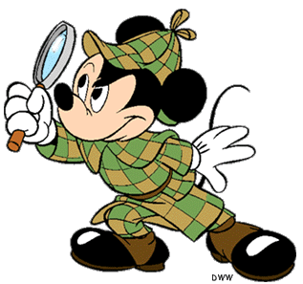
Research The Organization
This will help you answer questions – and stand out from less-prepared candidates
1.) Seek background information
2.) Get perspective
3.) Develop a question list

Slide 3
Seek Background Information
Use tools like Vault, CareerSearch or The Riley Guide for an overview of the organization and its industry profile
Visit the organization’s website to ensure that you understand in depth what they do
Review the organization’s background and mission statement
Assess their products, services and client-base
Read recent press releases for insight on projected growth and stability

Slide 4
Get Perspective
Review trade or business publications. Seek perspective and a glimpse into their industry standing

Slide 5
Develop a Question List
Prepare to ask about the organization or position based on your research

Slide 6
Compare Your Skills and Qualifications To The Job Requirements
Analyze the job description: outline the knowledge, skills, and abilities required
Examine the hierarchy: determine where the position fits within the organization
Look side-by-side: compare what the employer is seeking to your qualifications

Slide 7
Prepare Responses
Most interviews involve a combination of resume-based, behavioral and case questions.

Slide 8
Plan What To Wear
Go Neutral: Conservative business attire, such as a neutral-colored suit and professional shoes, is best.
Err Formal: If instructed to dress “business casual,” use good judgement
Plug In That Iron: Make sure your clothes are neat and wrinkle-free
Dress To Impress: Be sure that your overall appearance is neat and clean

Slide 9
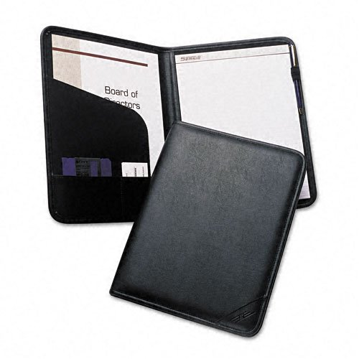
Plan What To Bring
Extra copies of your resume on quality paper
A notepad or professional binder and pen
A list of references
Information you might need to complete an application
A portfolio with samples of your work, if relevant

Slide 10
Pay Attention To Non-Verbal Communication
Be Mindful: Nonverbal communication speaks volumes
Start Ahead: Remember that waiting room behaviors may be reported
Project Confidence: Smile, establish eye contact and use a firm handshake
Posture Counts: Sit up straight yet comfortably. Be aware of nervous gestures such as foot-tapping, rocking, swaying back and forth, and playing with hands.

Slide 11
Pay Attention To Non-Verbal Communication Cont’d
Be Attentive: Don’t stare, but maintain good eye contact, while addressing all aspects of an interviewer’s questions.
Respect Their Space: Do not place anything on their desk
Manage Reactions: Facial expressions provide clues to your feelings. Manage how you react, and project a positive image.

Slide 12
Follow Up
Many interviews end with, “Do you have any questions?”
Bring a list
Be strategic – Cover information not discussed or clarify a previous topic
Example: Tell me about the organizations culture.
Write a thank you letter within 2 weeks after your interview thanking them for the opportunity to have an interview.

Slide 13
Page 20 Ag Mechanics Book
Refer to page 20 in your Ag Mechanics Book and choose questions that would help prepare you for your interviews.

